Slide 1
Understanding social media acceptance and use in the context of technology generations and life-based design
INFuture2011, Zagreb, Croatia Mari Ylikauppila VTT Technical Research Centre of Finland

Slide 2
Understanding social media acceptance and use in the context of technology generations and life-based design
VTT Technical Research Centre of Finland
Jaana Leikas
Mari Ylikauppila
University of Jyväskylä
Jussi Jokinen
Rebekah Rousi
Pertti Saariluoma

Slide 3
Introduction
Purpose is to understand the differences in usage of social media by people of different ages.
Life-based design
Technology generations
Social media services
have promptly found a place in human everyday life
create possibilities for social contacts
allow people to build new types of networks
-> promote psychological well-being
-> enhance quality of life

Slide 4
Life-based design
Life-based design is a design paradigm with key idea of investigating the HTI design process in the concepts pertaining to research into human life.
The sociology, psychology and biology of human life form the basic conceptualization, methodology and factual basis for design.
The combination of factors -> Life settings of people
age, family and marital status, social status, profession, health issues, education, gender, skills, technology generation

Slide 5
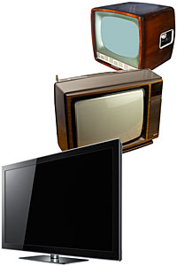
Technology generations
Technology generations reflect the historical timing of computing innovations and their diffusion into productive and cultural spheres, linked with the time period in which a cohort comes of age.
People learn to use technologies at a certain age, and this understanding of how to use technologies (present and future) is built on the kind of knowledge that is typical for that cohort.

Slide 6
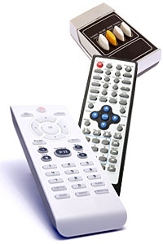
Technology generations Docampo Rama (2001)
Technological eras
Mechanical style: -> 1930/1940
Electro-mechanical style: available 1930-1980
Display style: available 1980-1990
Menu style: implemented 1990
-> Technology generations
Electro-mechanical generation: born before 1930
Display generation: born 1960-1970
Menu generation: born after 1970

Slide 7
Empirical study
Purpose:
Explore the differences in use of social media between technology generations
-> Implications for design
Method:
Focus Groups
Questionnaire: Use of online services and social media
Discussion: Usability of existing products, technology generations, life setting (form of life), social relationship, trust and privacy

Slide 8
Empirical study - Participants
In total 6 focus group sessions were held in Finland and in Australia.
31 Finnish citizens
14 Australian citizens
Technology Generations used in the study:
Electro/Mechanical Generation
born before 1965
22 participants
Layered Interface Generation
born 1965-1980
9 participants
Games Generation
born 1981-1992
14 participants

Slide 9
Differences in use of social media between technology generations
Do these three predetermined technological generation groups represent the reality?
Two different groups: Teenage experience with ICT – No teenage experience
The use of social media.
Basic use of social media is rather similar between different generations.
Young people use special functionalities more than older users.
The frequency of technological activity.
All age groups were equally active in their usage of social media.
Trust in social media.
Older people have much less trust in social media than young people.

Slide 10
Implications for design
Two important features for designers:
In technological usage there are many standard features. Skilled and interested users do not differ much from between each other.
There are issues in which generations do differ (trust and privacy).
-> Designers must understand the logic which differentiates the different generations.

Slide 11
Future work
International web survey to get better understanding of
Technology generations
Forms of life
Social relationships
- > A tool for designers to understand differences in human behaviour and the acceptance of new technologies.

Slide 12
Thank you for your attention.

